Slide 1
Discussion Unit: DSE Analytics
Streaming use cases
Blocking operators
Streaming sources
Reliable receivers
Spark 2.0; production ready, RDD
Spark 2.2; DataFrames, Datasets, windows, other
Stateful, stateless transforms
Window functions
Window sizing
Examples
Writing
Streaming, Streaming Analytics
Notes:
The goal of this Discussion Unit is to understand and use:
Streaming use cases
Blocking operators
Streaming sources
Reliable receivers
Spark 2.0; production ready, RDD
Spark 2.2; DataFrames, Datasets, windows, other
Stateful, stateless transforms
Window functions
Window sizing
Examples
Writing

Slide 2
Discussion Lab:
Attributes of Streaming, Streaming Analytics
Matching pairs – Match the attributes on the right with the areas on the left
Notes:
On the next page we enter a Discussion Lab; attributes of streaming, streaming analytics

Slide 3



DSE Analytics: Streaming, Not-streaming
stdout/stderr (logs) stream from 100,000 servers, analyzed to correlate dependencies; will server-A issue impact server-B ?
Customer on the 800 number routed to specific customer service agent based on known conditions-
1200+ sensors on airplane, 4TB of data from 4 hour flight, monitored to predict failure before it happens
Inventory nearly gone, raise price before next price quote
Flow rate sensors on stream, it's raining hard; will it flood ?
Notes:
Match the attributes on the right with the areas on the left-
Discuss which (use cases) are streaming applications, stream analytics applications

Slide 4

SQL SELECT Clauses-
SELECT
o.order_num,
sum (i.total_price) price
FROM orders o, items i
JOINING
o.order_num = i.order_num
WHERE o.order_date > '01/01/89'
AND o.customer_num > 110
GROUP BY 1
ORDER BY 2
INTO TEMP my_tempTable;
Describe the clauses ?
Which are blocking ?
(What is blocking ?)
Notes:
Regarding the SQL statement above, answer the following:
What are the clauses to a SQL SELECT; name, function
Which are blocking

Slide 5
End of Discussion Lab:
Notes:
End of Discussion Lab-

Slide 6
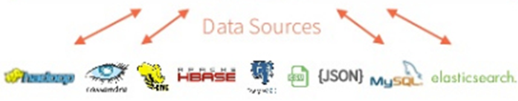
DSE Analytics: 5 Major Functional Areas
DataFrames
ML Pipelines
Spark SQL
Mllib/ML
GraphX
Spark Streaming
Spark Core
Image Source: DataBricks.com
Notes:
There is the main Spark engine (core), and on top of it fits Spark’s 4 main modules: 4 + 1 == 5
(Some diagrams will also highlight a 5'th main module, Spark/R.)
Spark SQL and Data Frames
Gives SQL like access to data, many ANSI standards implemented
Can access Hive, Avro, Parquet, ORC, JSON, and JDBC
Allows you to join across the various data sources
No ETL needed to process data
Spark Streaming
Often used with Kafka
Native APIs for Java, Scala and Python
MLlib (machine learning)
Machine Learning and all the goodness
that implies
GraphX with GraphFrames
DSE graph ties into GraphFrames
May optimize certain type of DSE Graph
Jobs
Reference Urls,
https://mapr.com/blog/5-minute-guide-understanding-significance-apache-spark/

Slide 7

DSE Analytics/Streaming: Where to Use
Streaming is often utilized in a DSE deployment
Monitor and act upon data as it is sent to DSE
Always on query, versus polling
DSE Analytics Streaming sources:
Kafka, ZeroMQ, MQTT
JMS systems like MessageQ, ActiveMQ
Twitter feeds
Stock feeds
CDC from other systems
HDFS, DSEFS, S3
Flume
TCP sockets
(Other)
Receiver Reliability: ACK/no-ACK, data loss is possible
Notes:
Spark streaming could be compared to always-on SQL queries; responding to data before it lands in DSE.
Numerous DSE Analytics streaming sources listed; reliable (guaranteed delivery), and non-reliable (no ACK waited for on send)

Slide 8
DSE Analytics/Streaming: History
Spark 2.0 (DSE 5.1), Streaming 'production ready'
RDD based, Dstreams (discretized)
Micro batches, each being an RDD
Fewer transforms (yes join, union; no intersect, .. )
Highest number of articles, examples
Spark 2.2 (DSE 6.0)
DataFrame, Dataset
Down to 1ms batch size
Catalyst optimizer
Automatic checkpointing
State management automatic
SQL access
Notes:
Spark 2.2.2 general availability release date was July 02, 2018. Thus:
Most customers still using earlier versions of Apache Spark; need to know
Spark 2.2 Streaming is a major advancement; DataFrames, SQL on Streams, more transforms
Reference Urls,
https://spark.apache.org/docs/latest/structured-streaming-programming-guide.html#streaming-deduplication
https://docs.datastax.com/en/dse/6.0/dse-dev/datastax_enterprise/releaseNotes/RNdse.html
https://docs.datastax.com/en/dse/5.1/dse-dev/datastax_enterprise/releaseNotes/RNdse.html

Slide 9
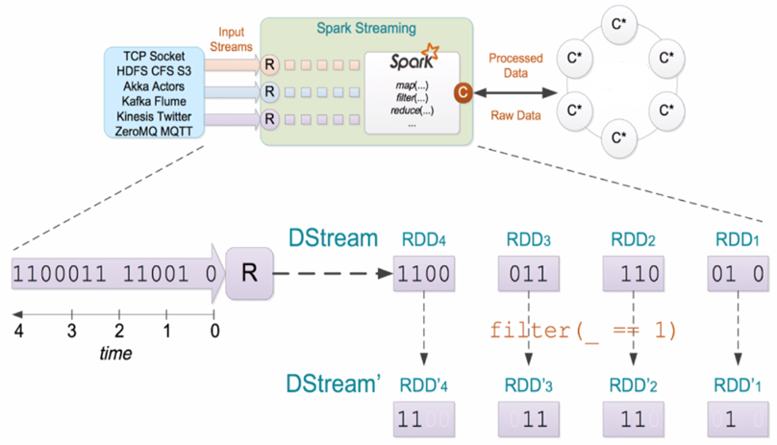
DSE Analytics: Streaming
Notes:
Walk through example of stream processing-
(RDDs) arrive over time as a discrete unit of data
Each (above) has transforms/other applied

Slide 10
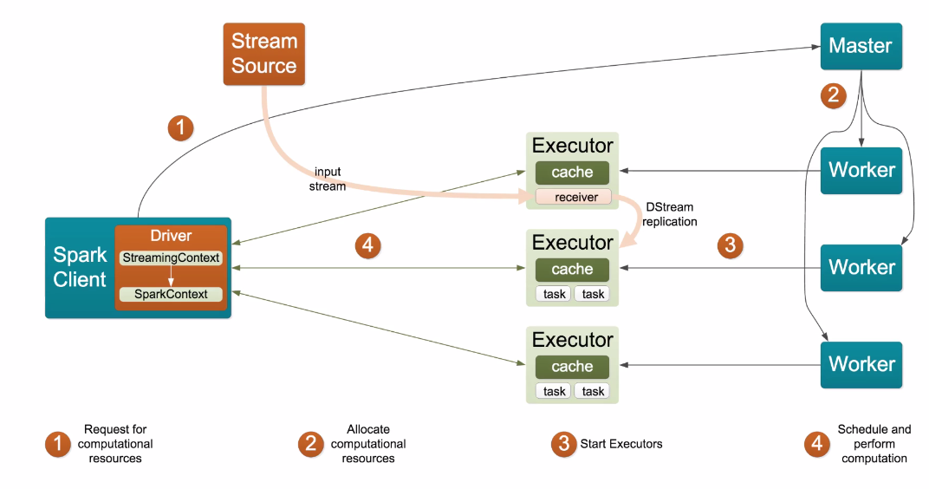
DSE Analytics: Streaming
Notes:
Process architecture using streams-
The executors never terminate (presumably)
Otherwise; generally the same as non-streaming
A StreamingContext object is using with SparkContext

Slide 11
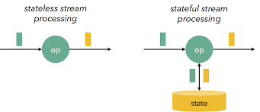
DSE Analytics, Streaming
Stateless Transforms
Notes:
Entering a section on the topic of stateless transforms.

Slide 12
Spark 2+, RDDs: DStream, Unary, Transform
Transformation
Description
filter(f)
New DStream, apply f() to elements of source Dstream, return where true
map(f)
New DStream, apply f() to each element, 1:1 input/output
flatMap(f)
New DStream, apply f(), 1:M input/output
New DStream, single element, number of elements in source DStream
count()
New DStream, count each distinct value in source, n == numTasks
countByValue(n)
Notes:
DSE Analytics streaming transforms; DStream, (RDD), unary

Slide 13
Spark 2+, RDDs: DStream, Unary, Transform
Transformation
Description
reduce(f)
New DStream, produce single element which is aggregate from source DStream
union(oDS)
New DStream, similar to union(oRDD), both DS must agree on time
transform(f)
New DStream, similar to foreach(), apply f() to every RDD in source DStream
Binary version of above. Both DStreams must agree on time
transformWith(oDS, f)
Notes:
DSE Analytics streaming transforms; DStream, (RDD), unary

Slide 14
Spark 2+, Pair RDDs: DStream, Unary, Transforms
Transformation
Description
mapValues(f)
New DStream, f(), each element of pair RDD, known to preserve key, 1:1
flatMapValues(f)
Similar to above, 1:M
reduceByKey(f [,n])
Aggregate function f(), n == num tasks
groupByKey(n)
Aggregate, no custom function, n == num tasks
Complex; combiner and merge f()'s, also merge combiners, can be written with multiples of above
combineByKey( .. )
Notes:
DSE Analytics streaming transforms; DStream, ( Pair RDD), unary

Slide 15
Spark 2+, Pair RDDs: DStream, Binary, Transforms
Transformation
Description
cogroup(oDS [,n]))
New DStream, similar to groupByKey()
join(oDS [,n])
New Dstream, similar to join()
leftOuterJoin( .. )
Left outer
rightOuterJoin( .. )
Right outer
** Each above: each participant must agree on time
Notes:
DSE Analytics streaming transforms; DStream, (RDD), binary

Slide 16
DSE Analytics, Streaming
Stateful Transforms
Notes:
Entering a section on the topic of stateful transforms.

Slide 17
Spark 2+, RDDs: DStream, Unary, w/ State
Transformation
Description
updateStateByKey(f [,n])
New "state" DStream formed, apply f() on each key of source RDD, n == num tasks
** Above: must enable checkpointing
Notes:
DSE Analytics streaming transforms; DStream, (RDD), unary, stateful

Slide 18
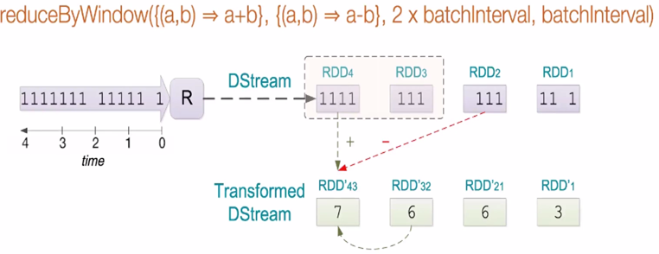
DSE Analytics: Windows, Slide or Tumble
Notes:
Regarding reduceByWindow:
Two function signatures (overloaded). This is the more advanced one.
Needs two accompanying functions; one to add, one to subtract.

Slide 19
Spark 2+, RDDs: DStream, Window Transforms
Transformation
Description
window(l, [i])
New DStream, combine all windowed batches from source DS, length, slideInterval
countByWindow(l [,i])
New DStream, Returns single element, count
countByWindowAnd
Value(l, i [,n])
New DStream, Count for each distinct element in source DS
New DStream, apply f() to each element in source DS, aggregate
reduceByWindow(f, l ,i)
Similar to above, second function to subtract, Ie., running average
reduceByWindow( .. )
Notes:
DSE Analytics streaming transforms; window transforms

Slide 20
Spark 2+, Pair RDDs: DStream, Window Transforms
Transformation
Description
reduceByKeyAnd
Window( .. )
Similar to reduceByKey, Pair RDD, additive
reduceByKeyAnd
Window( .. )
Similar to above, add and subtract
groupByKeyAnd
Window( .. )
Aggregate, no function
Notes:
DSE Analytics streaming transforms; window transforms

Slide 21

DSE Analytics: Window Length
Window Length
Minute scale window length reasonable
Hour scale not recommended
(Totals/Aggregates) okay
Window Sliding Interval
Per application requirements
Notes:
Sizing window length/interval.
Reference Urls,
1696, the Window Tax
https://en.wikipedia.org/wiki/Window_tax

Slide 22

DSE Analytics, Examples
Notes:
Entering a section on examples.

Slide 23
Example 1: Stateless, Word Count
now now now is the time for all good persons
keysspaces can span what?
-------------------------------------------
Time: 1533397030000 ms
-------------------------------------------
(persons,1)
(is,1)
(,3)
(now,3)
(all,1)
(good,1)
(for,1)
(time,1)
(the,1)
-------------------------------------------
Time: 1533397040000 ms
-------------------------------------------
(can,1)
(span,1)
(keysspaces,1)
(what?,1)
Sample input
Sample output
Second terminal,
nc –lk 9999
Notes:
Relative to the above example:
The command word count example, using streaming
Sample data, and sample output above
Use a second terminal running "nc –lk 9999", to send text data to port 9999.

Slide 24
Example 1: Stateless, Word Count
package com.datastax.enablement.bootcamp
// Spark Core
import org.apache.spark.{SparkConf, SparkContext}
import org.apache.spark.SparkContext._
// Spark streaming
import org.apache.spark.streaming._
import org.apache.spark.streaming.StreamingContext._
// DSE Spark Cassandra Connector
import com.datastax.spark.connector._
import com.datastax.spark.connector.streaming._
Notes:
Relative to the above example:
The package and imports

Slide 25
Example 1: Stateless, Word Count
object App {
def main(args: Array[String]) {
val conf = new SparkConf(true).
setAppName("My App").
setMaster("dse://127.0.0.1?").
set("spark.cleaner.ttl", "3600")
val ssc = new StreamingContext(conf, Seconds(10))
val stream = ssc.socketTextStream("127.0.0.1", 9999)
Notes:
Relative to the above example:
A Spark streaming SparkConf handle; the DSE Spark Connector (driver) will find the master IP and port number
Setting the batch window to 10 seconds.
Opening a receiver of type, socketTextStream

Slide 26
Example 1: Stateless, Word Count
stream.flatMap(r => r.split(" ")).
map(t => (t, 1)).
reduceByKey(_ + _).
print()
ssc.start()
ssc.awaitTermination()
}
Notes:
Relative to the above example:
flatMap(), split(), map() and reduceByKey() should be familiar from earlier examples

Slide 27

Example 2: Stateless, reduceByCount()
IOT, Apache Http Web server
10.14.246.11 122.93.102.53 - - [25/Oct/2011:01:41:00 -0500]
"GET /download/download6.zip HTTP/1.1" 200 3067
"-" "Mozilla/5.0 (Windows; U; Windows NT 5.1; en-US; \
rv:1.9.0.19) Gecko/2010031422 Firefox/3.0.19"
Sample input
Notes:
Relative to the above example:
All further examples receive 10 rows of data from a signal generator; shown on following page
Data is similar to an Apache Http Web server

Slide 28
Example 2: Stateless, reduceByCount()
-------------------------------------------
Time: 1533397460000 ms
-------------------------------------------
(10.14.246.11,2)
(10.14.246.12,7)
(10.14.246.10,1)
-------------------------------------------
Time: 1533397470000 ms
-------------------------------------------
(10.14.246.11,3)
(10.14.246.13,3)
(10.14.246.12,4)
-------------------------------------------
Time: 1533397480000 ms
-------------------------------------------
(10.14.246.11,2)
(10.14.246.12,8)
Sample output
Notes:
Relative to the above example:
Sample output

Slide 29

Example 2: Stateless, reduceByCount()
#!/usr/bin/bash
l_cntr1=0
l_cntr2=0
function slow_cat() {
while read
do
[ "$l_cntr1" -ge 10 ] && {
sleep 10
(>&2 echo " Loop Counter (10 rows output): "${l_cntr2})
l_cntr1=0
}
#
((++l_cntr1))
((++l_cntr2))
#
echo "$REPLY"
done
}
cat 02_WebLogAll.txt | slow_cat | nc -lk 9999
Signal generator
Notes:
Relative to the above example:
A signal generator written on Bash; basically a slow cat command

Slide 30
Example 2: Stateless, reduceByCount()
package com.datastax.enablement.bootcamp
// Spark Core
import org.apache.spark.{SparkConf, SparkContext}
import org.apache.spark.SparkContext._
// Spark Streaming
import org.apache.spark.streaming._
import org.apache.spark.streaming.StreamingContext._
// DSE Spark Cassandra Connector
import com.datastax.spark.connector._
import com.datastax.spark.connector.streaming._
Notes:
Relative to the above example:
Package and import statements

Slide 31
Example 2: Stateless, reduceByCount()
object App {
def main(args: Array[String]) {
// This area has changed alot since 5.x.
//
// Code below tested and works on 6.0
val conf = new SparkConf(true).
setAppName("My App").
setMaster("dse://127.0.0.1?").
set("spark.cleaner.ttl", "3600")
val ssc = new StreamingContext(conf, Seconds(10))
val stream = ssc.socketTextStream("127.0.0.1", 9999)
Notes:
Relative to the above example:
No new code above; just providing a complete example

Slide 32
Example 2: Stateless, reduceByCount()
stream.map(r => (r.split(" ")(0), 1)).
reduceByKey(_+_).
print()
// Or, more simply
//
// stream.map(r => r.split(" ")(0)).
// countByValue().
// print()
ssc.start()
ssc.awaitTermination()
}
}
Notes:
Relative to the above example:
reduceByKey() and countByValue() can be interchanged in this use

Slide 33
Example 3: Stateful, updateStateByKey()
-------------------------------------------
Time: 1533397610000 ms
-------------------------------------------
(10.14.246.13,10)
(10.14.246.10,12)
(10.14.246.11,1)
(10.14.246.12,37)
-------------------------------------------
Time: 1533397620000 ms
-------------------------------------------
(10.14.246.13,10)
(10.14.246.10,13)
(10.14.246.11,10)
(10.14.246.12,37)
Sample output
Notes:
Relative to the above example:
Sample output; notice that the counts are incrementing

Slide 34
Example 3: Stateful, updateStateByKey()
package com.datastax.enablement.bootcamp
// Spark Core
import org.apache.spark.{SparkConf, SparkContext}
import org.apache.spark.SparkContext._
// Spark Streaming
import org.apache.spark.streaming._
import org.apache.spark.streaming.StreamingContext._
// DSE Spark Cassandra Connector
import com.datastax.spark.connector._
import com.datastax.spark.connector.streaming._
Notes:
Relative to the above example:
Package and import statements

Slide 35
Example 3: Stateful, updateStateByKey()
object App {
def main(args: Array[String]) {
val conf = new SparkConf(true).
setAppName("My App").
setMaster("dse://127.0.0.1?").
set("spark.cleaner.ttl", "3600")
val ssc = new StreamingContext(conf, Seconds(10))
//
ssc.checkpoint("dsefs:///tmp")
val stream = ssc.socketTextStream("127.0.0.1", 9999)
Notes:
Relative to the above example:
RDD objects/transforms require manual checkpointing configuration

Slide 36
Example 3: Stateful, updateStateByKey()
def updateRunningCount(newValues: Seq[Long],
oldValues: Option[Long]) : Option[Long] = {
if (newValues.isEmpty)
Some(oldValues.getOrElse(0L))
else
Some(oldValues.getOrElse(0L) + newValues(0))
}
stream.map(r => r.split(" ")(0)).
countByValue().
updateStateByKey[Long](updateRunningCount _).
print()
Notes:
Relative to the above example:
Functional programming; updateStateByKey knows to pass the key values automatically, and these keys are not mutable/accessible
The value is cast as a long
The initial/new value is sent each time
On second and subsequent invocations, the prior value is also sent (hence, option)
A return value is sent as long, but is optional a required by the final invocation

Slide 37
Example 3: Stateful, updateStateByKey()
// stream.map(r => r.split(" ")(0)).
// reduceByWindow({ (nv, ov) => nv+ov}, Seconds(60),
// Seconds(10)).
// print()
//
// Essentially a concat of the IP addr; not useful
ssc.start()
ssc.awaitTermination()
}
}
Notes:
Relative to the above example:
No new code to discuss

Slide 38
Example 4: Stateful, with initial values
-------------------------------------------
Time: 1533398970000 ms
-------------------------------------------
(10.14.246.13,1087)
(10.14.246.13,1088)
(10.14.246.13,1089)
(10.14.246.11,86)
(10.14.246.12,633)
(10.14.246.12,634)
(10.14.246.12,635)
(10.14.246.12,636)
(10.14.246.12,637)
(10.14.246.12,638)
Sample output
Notes:
Relative to the above example:
And example with initial state values

Slide 39
Example 4: Stateful, with initial values
package com.datastax.enablement.bootcamp
// Spark Core
import org.apache.spark.{SparkConf, SparkContext}
import org.apache.spark.SparkContext._
// Spark Streaming
import org.apache.spark.streaming._
import org.apache.spark.streaming.StreamingContext._
// DSE Spark Cassandra Connector
import com.datastax.spark.connector._
import com.datastax.spark.connector.streaming._
Notes:
Relative to the above example:
Package and imports

Slide 40
Example 4: Stateful, with initial values
object App {
def main(args: Array[String]) {
val conf = new SparkConf(true).
setAppName("My App").
setMaster("dse://127.0.0.1?").
set("spark.cleaner.ttl", "3600")
val ssc = new StreamingContext(conf, Seconds(10))
//
ssc.checkpoint("dsefs:///tmp")
val lines = ssc.socketTextStream("127.0.0.1", 9999)
Notes:
Relative to the above example:
No new code to discuss

Slide 41
Example 4: Stateful, with initial values
val initialRDD = ssc.sparkContext.parallelize(List(
("10.14.246.12", 500), ("10.14.246.13", 1000)))
val wordDstream = lines.map(r => (r.split(" ")(0), 1))
val mappingFunc = (word: String, one: Option[Int],
state: State[Int]) => {
val sum = one.getOrElse(0) + state.getOption.getOrElse(0)
val output = (word, sum)
state.update(sum)
output
}
Notes:
Relative to the above example:
initialRDD must match the signature of the (working) RDD
wordStream is a transform
mappingFunc is a function; functions as data, structured programming

Slide 42
Example 4: Stateful, with initial values
val stateDstream = wordDstream.mapWithState(
StateSpec.function(mappingFunc).initialState(initialRDD))
stateDstream.print()
ssc.start()
ssc.awaitTermination()
}
}
Notes:
Relative to the above example:
mapWithState with one argument, the transform function titled, mappingFunc
mappingFunc can be fluent with an optional initialState function, accepting initial values

Slide 43
Example 5: Datasets (stateful) G/A July 2, 2018
// -------------------------------------------
// Batch: 29
// -------------------------------------------
// +------------+-----+
// | value|count|
// +------------+-----+
// |10.14.246.11| 69|
// |10.14.246.12| 177|
// |10.14.246.13| 63|
// |10.14.246.10| 71|
// +------------+-----+
//
// -------------------------------------------
// Batch: 30
// -------------------------------------------
// +------------+-----+
// | value|count|
// +------------+-----+
// |10.14.246.11| 78|
// |10.14.246.12| 177|
// |10.14.246.13| 63|
// |10.14.246.10| 72|
// +------------+-----+
Sample output
Notes:
Relative to the above example:
Using Datasets

Slide 44
Example 5: Datasets (stateful)
package com.datastax.enablement.bootcamp
import org.apache.spark.sql.SparkSession
object App {
def main(args: Array[String]) {
val host = "localhost"
val port = 9999
val spark = SparkSession
.builder
.appName("My App")
.getOrCreate()
import spark.implicits._
Notes:
Relative to the above example:
Package and import
Different SparkSession definition
implicits._ gives us access to many Spark/SQL functions

Slide 45
Example 5: Datasets (stateful)
val lines = spark.readStream
.format("socket")
.option("host", host)
.option("port", port)
.load()
val words = lines.as[String].map(r => r.split(" ")(0))
// println(words.getClass)
// class org.apache.spark.sql.Dataset
val wordCounts = words.groupBy("value").count()
val query = wordCounts.writeStream
.outputMode("complete")
.format("console")
.start()
Notes:
Relative to the above example:
Opening the receiver
The getClass confirms our object type
groupBy(), a Spark/SQL transform
And an output

Slide 46
Example 5: Datasets (stateful)
query.awaitTermination()
}
}
Notes:
Relative to the above example:
No new code to discuss

Slide 47
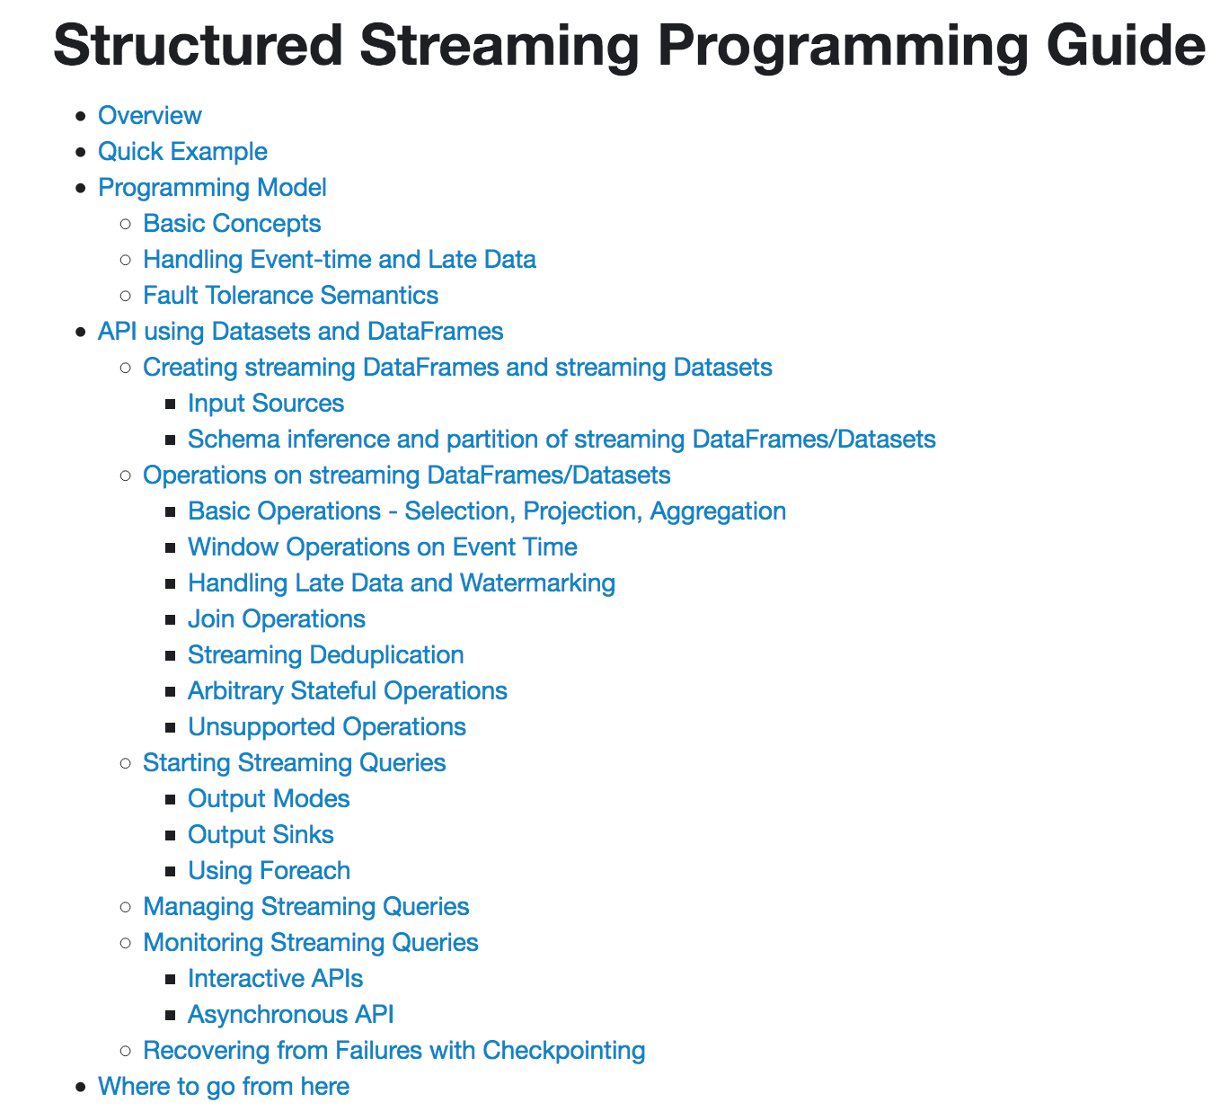
DSE Analytics: Spark 2.2+
For all new work
G/A July 2, 2018
DataFrames/Datasets
Auto checkpoint/stateful
More complete transforms
Notes:
Relative to the above example:
As stated, Spark Streaming 2.2 is greatly enhanced, including DataFrames, Datasets, and many higher level APIs.
Reference Urls,
https://spark.apache.org/docs/2.2.0/structured-streaming-programming-guide.html

Slide 48
DSE Analytics: Other
Parallelism
Number of receivers invoked
Number of partitions (same as before)
Persistence
Same as before (cache(), ..)
Checkpointing
Some transforms auto-checkpoint
updateStateByKey( .. )
countByWindow( .. )
(Other)
All window transforms
ssc.checkpoint("dsefs:///tmp")
ssc.checkpoint(Seconds(20))
Frequent, slower perf
Infrequent, slower failure recovery
Recommend: 5-10 x slide interval
Notes:
Relative to the above example:
Other topics related to streaming.
Reference Urls,
https://spark.apache.org/docs/2.2.0/structured-streaming-programming-guide.html

Slide 49
DSE Analytics: Writing
Output Operation
Description
print()
Print first 10 elements of each RDD in the source DStream
saveAsTextFiles()
saveAsObjectFiles()
saveAsHadoopFiles()
Save each DStream in format/location specified.
Apply f() to each RDD in source DStream. Can use any transform/actions on input RDD.
foreachRDD(f)
saveToCassandra()
Write to DSE Core; ks, table, [columns]
Notes:
Relative to the above example:
Specific mention to output functions.
Reference Urls,
https://spark.apache.org/docs/2.2.0/structured-streaming-programming-guide.html

Slide 50
End of Unit:
Notes:
End of Discussion Unit-

